Slide 1


Slide 2
What is Apache Spark?
Definition: Apache Spark is an open-source unified analytics engine for large-scale data processing.
Key Features:
In-memory computing for faster processing
Scalable and fault-tolerant
Supports multiple languages (Java, Scala, Python, R)
Integrated with Hadoop, Hive, and other big data tools

Slide 3
History of Apache Spark
2010: Developed at UC Berkeley's AMPLab.
2012: Open-sourced under the Apache License.
2014: Became an Apache Top-Level Project.
2016: Spark 2.0 introduced Structured Streaming and other enhancements.
2020s: Ongoing updates and new features such as improved MLlib and GraphX.

Slide 4
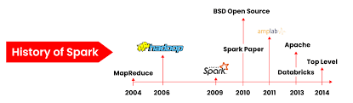

Slide 5
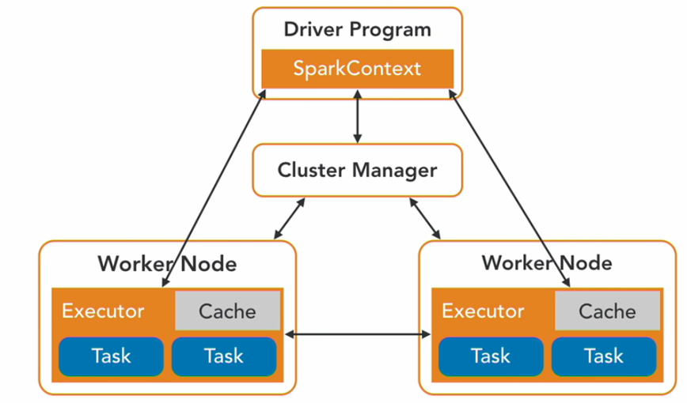
SPARK Architecture

Slide 6
SPARK Architecture
Components:
Driver Program: Manages the execution of the Spark application.
Cluster Manager: Manages resources and schedules tasks (e.g., YARN, Mesos, Kubernetes).
Executors: Execute tasks and store data.
Worker Nodes: Machines that provide the resources (CPU, memory) for Spark tasks.
Data Flow:
Job: High-level unit of work submitted by the driver.
Stage: Phases of the job divided based on transformations.
Task: Smallest unit of work that runs on executors.
Notes:
https://spark.apache.org/docs/latest/cluster-overview.html

Slide 7
Spark Shell
Description: An interactive shell for running Spark commands.
Types:
Spark Scala Shell: Use Scala to interact with Spark.
Spark Python Shell (PySpark): Use Python for interactive data analysis.
Basic Commands:
spark-shell (Scala)
pyspark (Python)

Slide 8
PySpark Shell:
textFile = sc.textFile("hdfs://.../file.txt")
counts = textFile.flatMap(lambda line: line.split(" ")) \
.map(lambda word: (word, 1)) \
.reduceByKey(lambda a, b: a + b)
print(counts.collect())
Notes:
textFile = sc.textFile("hdfs://.../file.txt")
counts = textFile.flatMap(lambda line: line.split(" "))
\ .map(lambda word: (word, 1))
\ .reduceByKey(lambda a, b: a + b)
print(counts.collect())

Slide 9
PySpark Introduction
Definition: PySpark is the Python API for Spark, allowing users to harness the simplicity of Python and the power of Apache Spark.
Key Features:
RDD (Resilient Distributed Dataset): Fundamental data structure in Spark.
DataFrames: Higher-level abstraction for structured data.
SQL Queries: Run SQL queries using Spark SQL.
MLlib: Machine learning library.
GraphX: Graph processing library.
Example Code:
Simple PySpark DataFrame Operation:

Slide 10
from pyspark.sql import SparkSession
spark = SparkSession.builder.appName("example").getOrCreate()
# Create DataFrame
df = spark.createDataFrame([(1, 'Alice'), (2, 'Bob')], ['id', 'name'])
# Show DataFrame
df.show()

Slide 11


